Slide 1
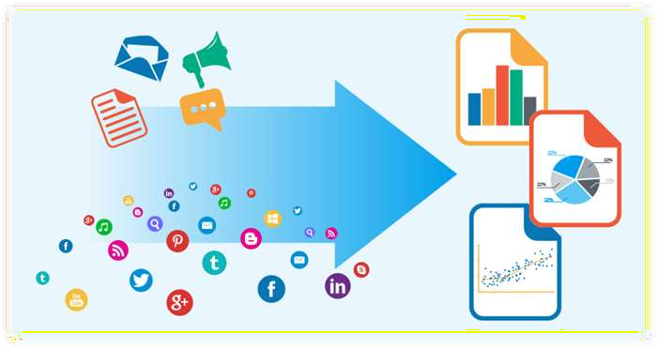
Sentiment Analysis
Team Warriors
( Aniket, Kumud and Swati )
20-July-2020

Slide 2
Table of Contents
Dataset Overview
Exploratory Data Analysis (EDA)
Pipeline
Models and Approaches
Insights and Decisions
Notes:
Can we include some examples here?

Slide 3
Problem Statement
WittyWicky Inc. is a consulting firm that designs brand strategy
BUSINESS PROBLEM
DATA SCIENCE PROBLEM
Analysing the positive and negative sentiments about brand/product through social media so that new product can be launched as per the trend in market.
New marketing strategy and brand stragegy can be designed for products after reviewing customers sentiments
Build a product/model using
Machine Learning or deep learning
to automate sentiment prediction.
Notes:
Can we include some examples here?

Slide 4





What sentiment analysis can do for Brands?
Resolve Customer Experience Pain Points
Optimize Customer Service
Increase Customer Retention
Optimize Pricing
Measure Social Media ROI

Slide 5
Data
Column | Description
tweet_id | Unique id for tweets
tweet | Tweet about the brand/product sentiment
sentiment | 0: Negative, 1: Neutral, 2: Positive, 3: Can't Tell

Slide 6
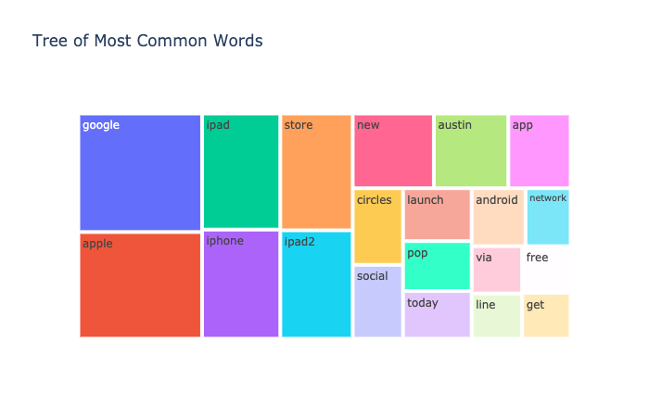
EDA

Slide 7
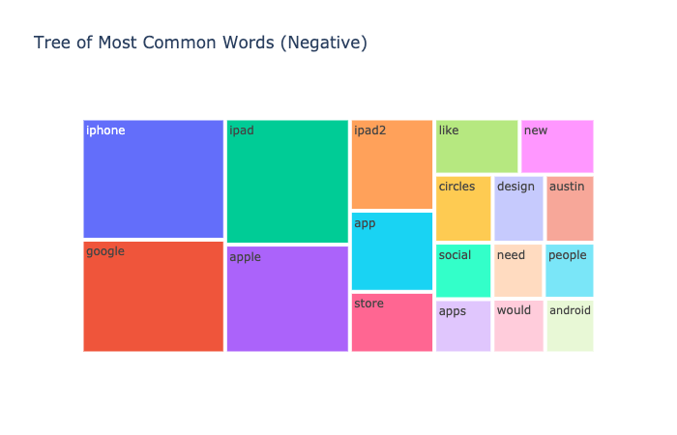
EDA

Slide 8
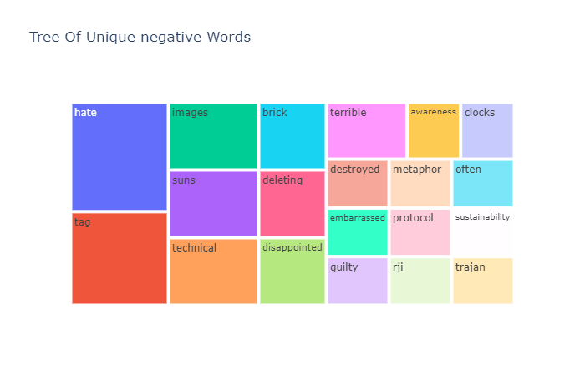
EDA

Slide 9
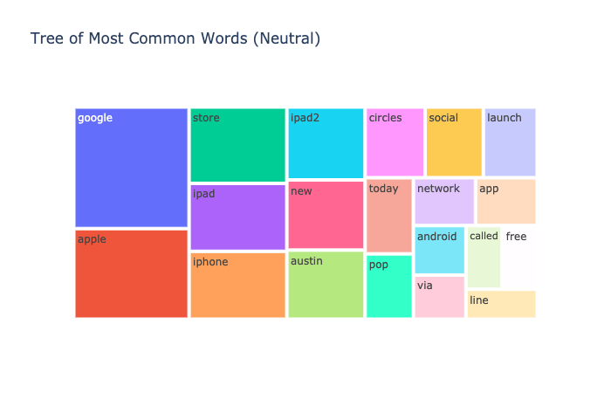
EDA

Slide 10
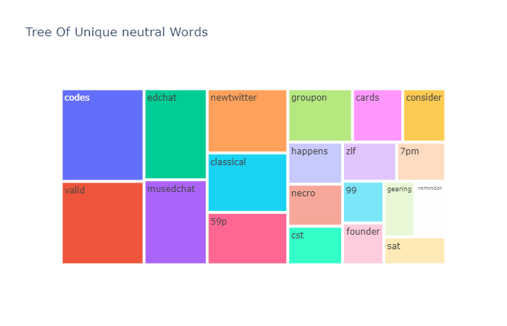
EDA

Slide 11
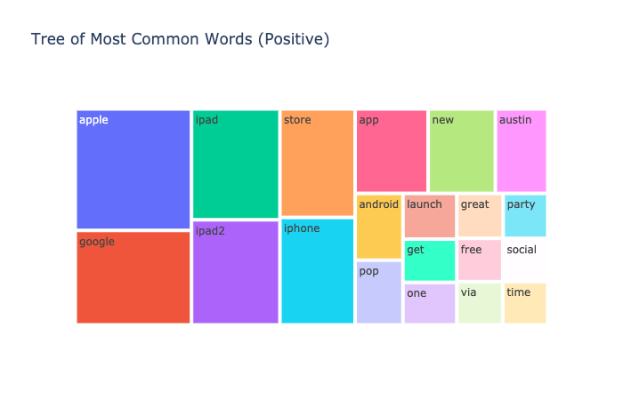
EDA

Slide 12
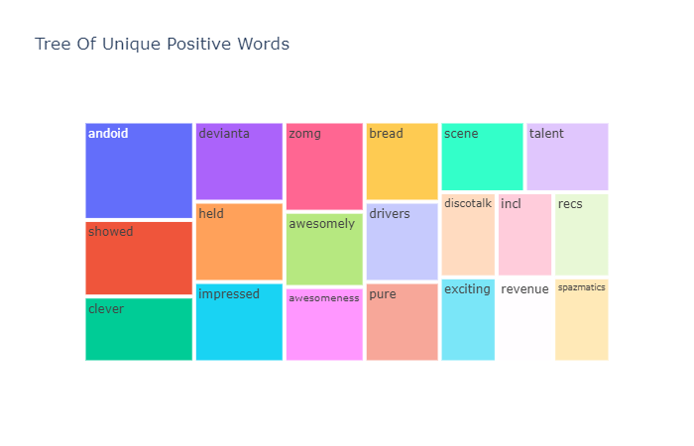
EDA

Slide 13
Comparision of word count in positive and negative tweets
Positive tweets | count
ipad | 823
apple | 743
google | 580
iphone | 447
Negative tweets | count
ipad | 159
apple | 130
google | 119
iphone | 100

Slide 14
EDA Named-entity recognition
Entity with higher counts | Positive tweets | Negative tweets | Neutral tweets
org | Apple(102) Google(31) Google party(12) Microsoft (7) | Apple(21) google(11) Microsoft(3) | Apple(174) Google(73) Microsoft(11)
geo | Japan(14) U.S(7) | America,(11) Japan(9) | Japan(65)

Slide 15
Data cleaning
Mappings done eg.ipad 2 to ipad2
Text emojis replaced with their word synonyms (<3 converted to ‘love’)
HTML characters (eg: &lt; &gt; &quot;) and syntax (eg: <title>) removed
Links (http), short-links, date, time, non-ascii characters were removed
Substituted links and mentions removed
Hash symbol was removed, not the entire hash-tag

Slide 16
Pipeline
Word tokenization
Stemming
TF- IDF vectorizer

Slide 17
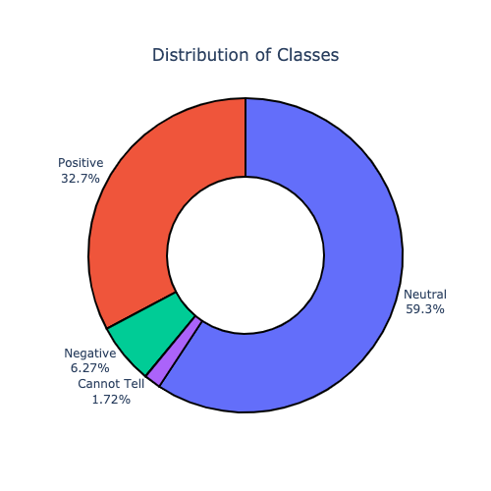
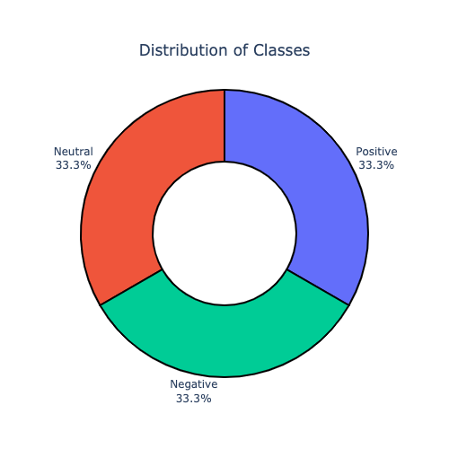
Imbalance data
Given data had imbalance in SENTIMENT so SMOTE oversampling is used.
Before applying smote
After applying smote

Slide 18
Models and Approaches
Multiple classification models were run on the data: Here are some numbers.
 | Logistic Regression | Random Forest | XGBoost
F1 SCORE (WEIGHTED) | 0.89 | 0.68 | 0.82
Hyperparameter tuning using Grid SearchCV for Logistic Regression
The F1 weighted score with final test data using Logistic Regression was 0.68

Slide 19
Models and Approaches
Using word2vec
 | Logistic Regression | Random Forest | XGBoost
F1 SCORE (WEIGHTED) | 0.51 | 0.57 | 0.57

Slide 20
Additional Approaches Attempted
Removing stop words
Finding sentiment polarity with Textblob
Finding sentiment polarity using Textblob, as per name entity recognition using spaCy
Lemmatization and GingerIt library used to correct spellings
Sentiment analysis with tensorflow and keras in progress

Slide 21
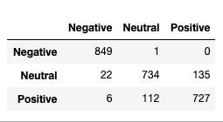
Final Results
Confusion Matrix
Model: Logistic Regression with 0.89 F1 weighted score(post oversampling)

Slide 22
There was excitement for Google Circles and the Google party organised at the event received mostly Positive sentiments.
Insights & Decisions
Positive tweets for Apple brand were very much higher than negative tweets.This shows customer Satisfaction for the product
Negative reviews about the battery life for the Apple products can help to improve the product further.
There was excitement for Google Circles and the Google party organised at the event received mostly Positive sentiments
Temporary retail shops of Apple was good marketing strategy to ease purchase
Addition of the Japan Disaster (Earthquake) Relief kiosk reflected positively on the overall event

Slide 23
Dataset Gaps
Sentence incompleteness
Lack of context
Topic Categories Differences
Isssue undermining analysis
Semantic ambiquity
Emerging terms

Slide 24
Thanks

